Slide 1
Remote Sensing Image Classification

Slide 2
Land-use and Land-cover
Land cover refers to the type of material present on the landscape (e.g., water, sand, crops, forest, wetland, human-made materials such as asphalt).
Land use refers to what people do on the land surface (e.g., agriculture, commerce, settlement).

Slide 3
LULC Classification Guide
Follow a classification scheme that should normally be:
• mutually exclusive (no taxonomic overlap of any classes e.g. deciduous forest and evergreen forest are distinct classes)
• exhaustive (all land-cover classes present in the landscape are accounted for and none have been omitted)
• hierarchical (sublevel classes may be hierarchically combined into a higher- level category; e.g. deciduous + evergreen -> forest)

Slide 4
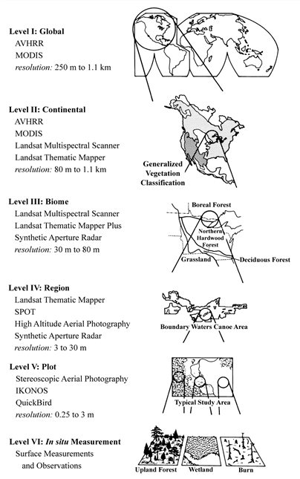
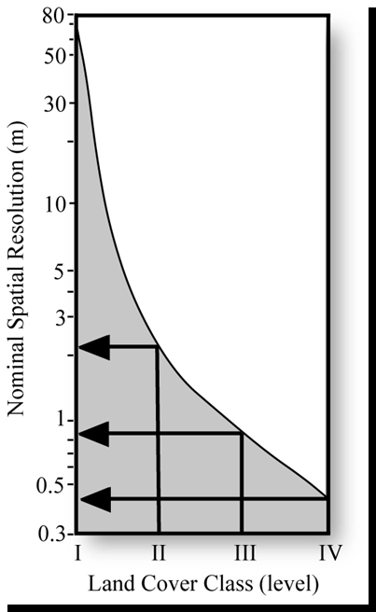
Which remote
sensing data?

Slide 5
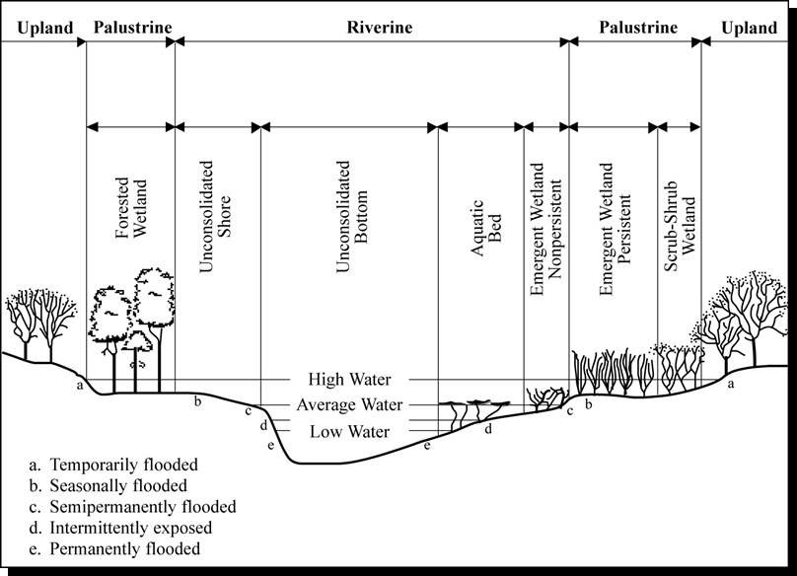
LULC Classification Schemes
U.S. Department of the Interior Fish & Wildlife Service
Classification of Wetlands and Deepwater Habitats of the United States

Slide 6
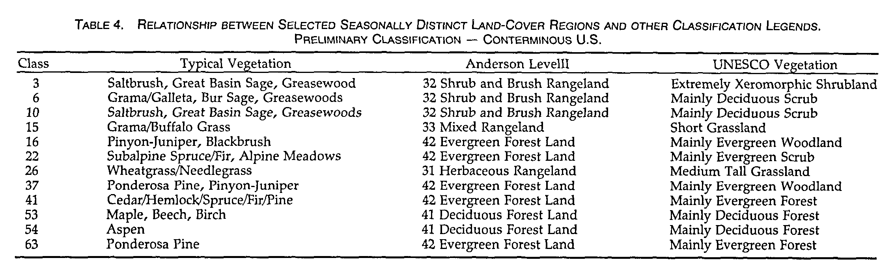
LULC Classification Schemes: Comparisons
Source: http://www.ciesin.org/docs/005-347/005-347.html
Notes:
It is better to adopt or modify existing nationally or internationally recognized classification systems. This allows us to interpret the significance of our classification results in light of other studies and makes it easier to share data.

Slide 7
Classification Methods
Parametric methods such as maximum likelihood classification and unsupervised clustering assume normally distributed remote sensor data and knowledge about the forms of the underlying class density functions.
Nonparametric methods such as nearest-neighbor classifiers, fuzzy classifiers, and neural networks may be applied to remote sensor data that are not normally distributed and without the assumption that the forms of the underlying densities are known.
Nonmetric methods such as rule-based decision tree classifiers can operate on both real-valued data (e.g., reflectance values from 0 to 100%) and nominal scaled data (e.g., class 1 = forest; class 2 = agriculture).

Slide 8
LULC classification training samples/ sites/ observations
Must be supplied for Supervised Classification
Geographic stratification to represent all landscape variabilities (e.g. spectral conditions for grassland found in the moist-soil portion of the study area will be different from dry-soil portion)
General rule of thumb: more than 10n pixels of training data for n bands (required by some classifier) (e.g. 60 pixels for a 6 band Landsat 5 data)
Independent samples needed for validation/accuracy assesment
Notes:
In a supervised classification, the identity and location of some of the land-cover types (e.g., urban, agriculture, or wetland) are known a priori through a combination of fieldwork, interpretation of aerial photography, map analysis, and personal experience. The analyst attempts to locate specific sites in the remotely sensed data that represent homogeneous examples of these known land-cover types. These areas are commonly referred to as training sites because the spectral characteristics of these known areas are used to train the classification algorithm for eventual land-cover mapping of the remainder of the image. Multivariate statistical parameters (means, standard deviations, covariance matrices, correlation matrices, etc.) are calculated for each training site. Every pixel both within and outside the training sites is then evaluated and assigned to the class of which it has the highest likelihood of being a member.

Slide 9
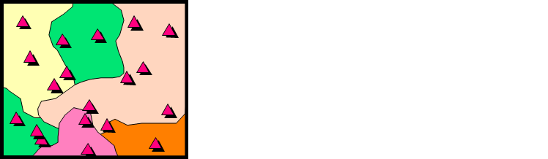
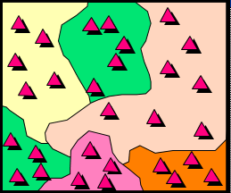
Simple Random vs Stratified Random Sampling
Minimum number of samples are selected from each category
Samples are randomly selected
samp1 <- sampleRandom(nlcd2011, size = 1500)
samp2 <- sampleStratified(nlcd2011, size = 50)
Notes:
Determining position and number of samples; Make sure to adequately sample the landscape; Variety of sampling schemes
Random, stratified random, systematic, systematic, systematic non-aligned, cluster; The more reference plots, the better
You can estimate how many you need statistically; In reality, you can never get enough: follow the 10n rules

Slide 10
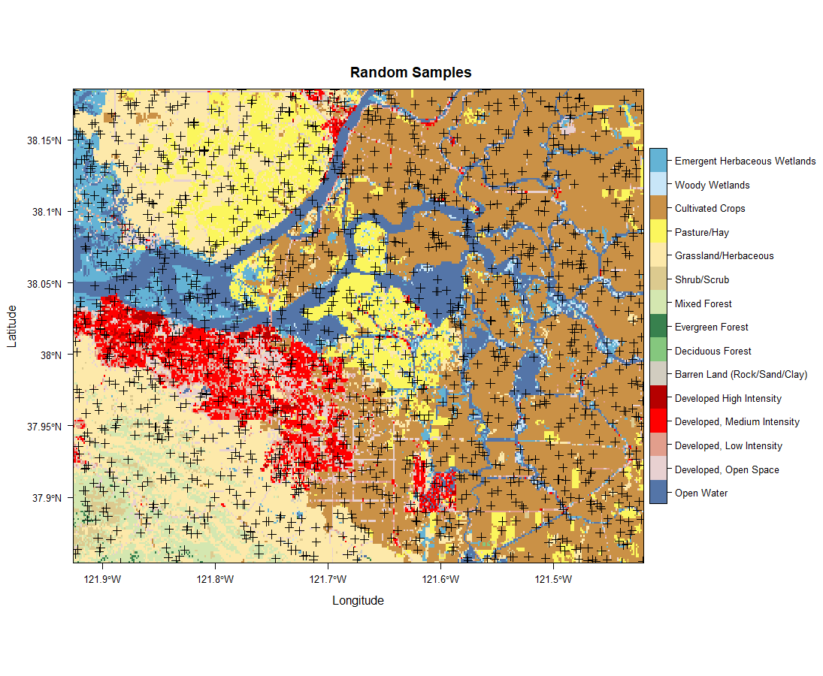
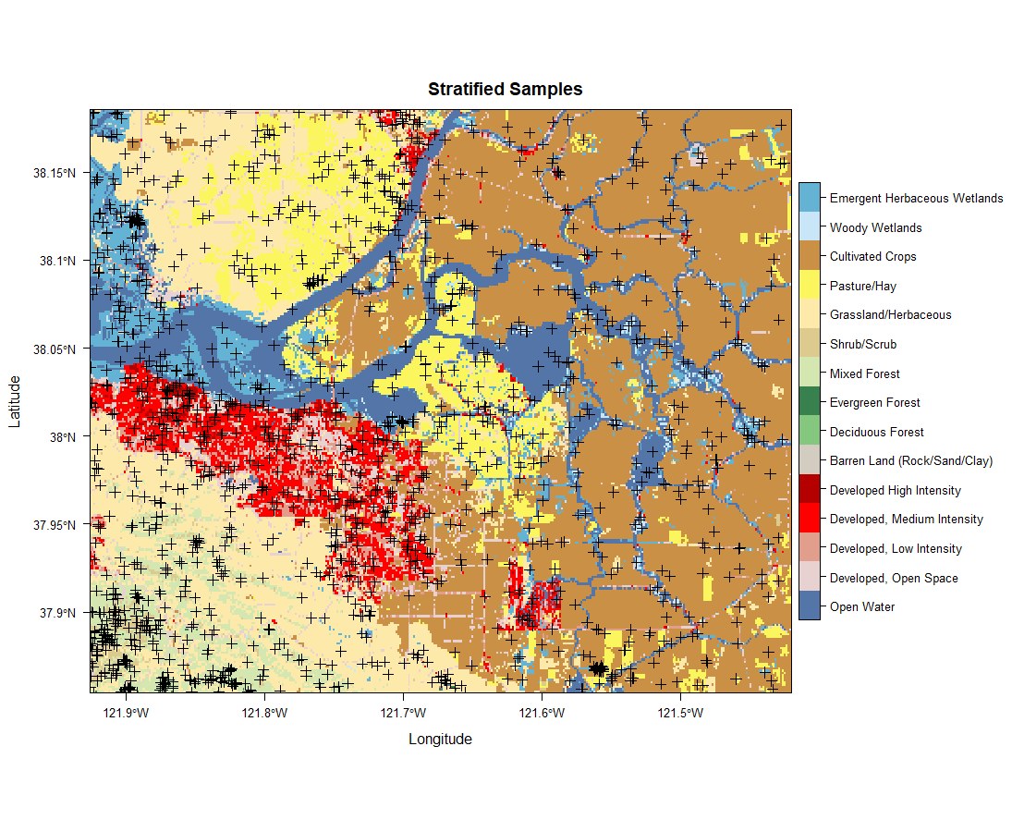
Geographic Stratification of Training Sites
levelplot(nlcd2011, col.regions = classcolor)+ layer(sp.points(samp1, pch = 3, cex = 0.75, col = 1))

Slide 11
Collecting training samples
(after adopting the classification scheme)
Can be points or polygons (area of interest, AOI)
Hi-resolution image interpretation: (e.g. Google Earth)
Existing reference layer (e.g.National Land Cover Database, NLCD)
Plan a field visit (with GPS, mobile devices)

Slide 12
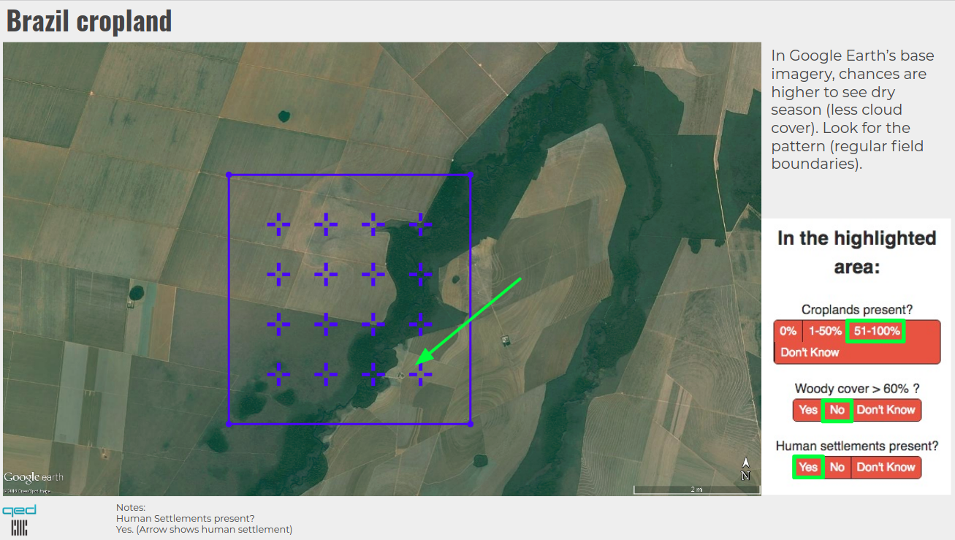
Use Google Earth/ Bing Map
https://geosurvey.qed.ai/howitworks/
Pure Pixel
Mixed Pixel

Slide 13
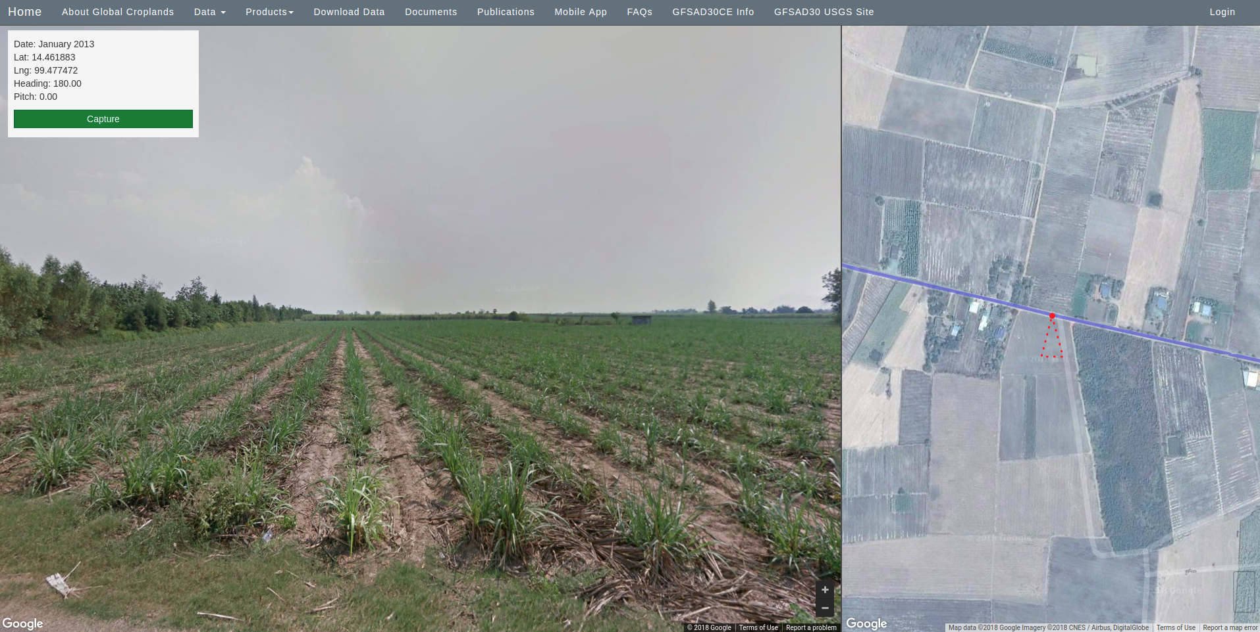
Design Google Earth/Map based interface
https://croplands.org/app/data/street

Slide 14
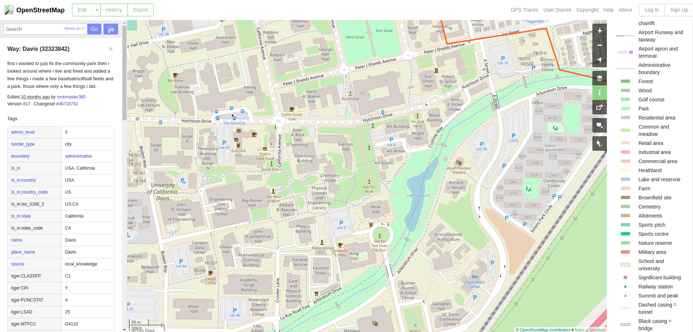
Use OpenStreetMap
https://www.openstreetmap.org/

Slide 15
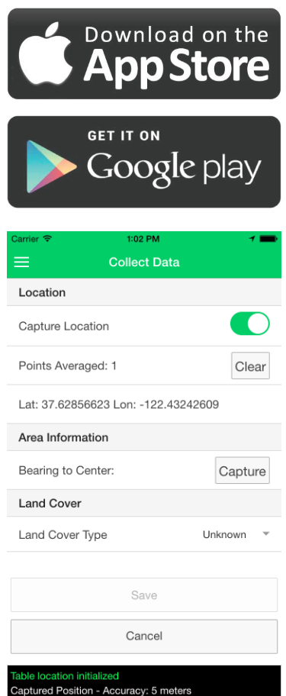
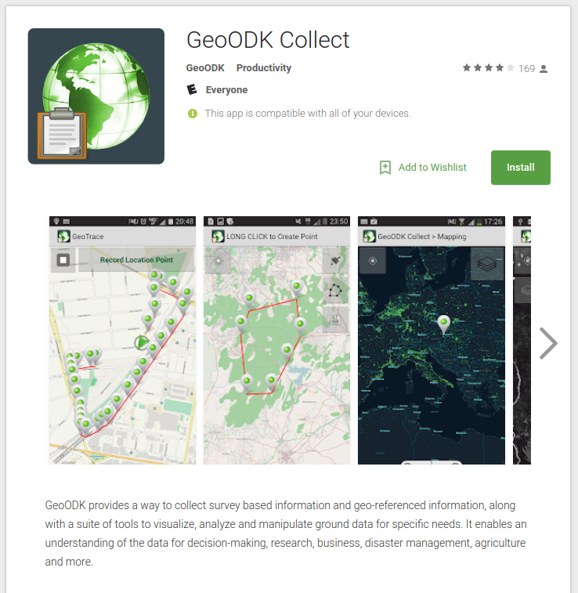
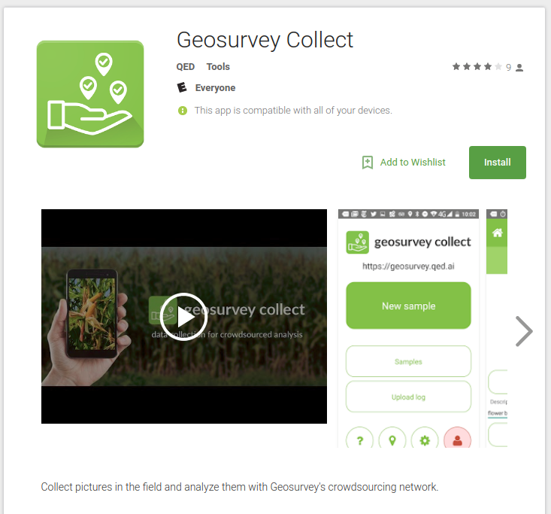
Design field visits with Mobile applications
https://croplands.org/app/
https://play.google.com/store/apps/details?id=com.geoodk.collect.android
https://play.google.com/store/apps/details?id=ai.qed.geosurvey.collect

Slide 16
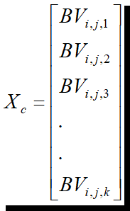
Extract Statistics for Training Sites
sampledata <- extract(landsat5, samples)
Each pixel in each training site associated with a particular class (c) is represented by a measurement vector, X_{c}:
k
where BV_{i,j,k} is the brightness value for the i,j^{th} pixel in band

Slide 17
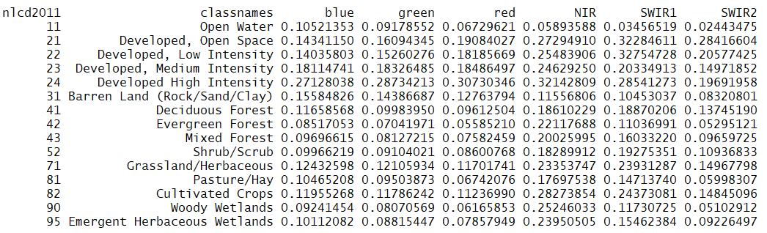
Extract Statistics for Training Sites
sampledata <- extract(landsat5, samples)
Each pixel in each training site associated with a particular class (c) is represented by a measurement vector, X_{c}:
k
Class (Open Water) is represented by a measurement vector with 6 bands.

Slide 18
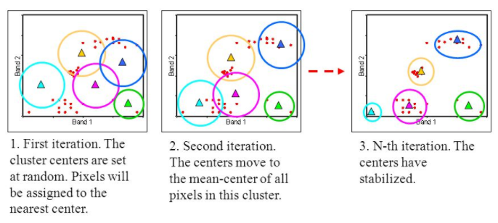
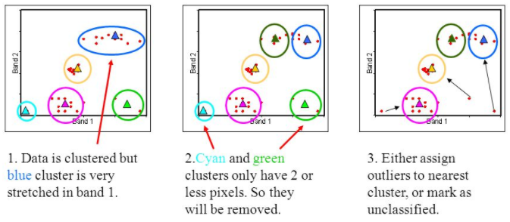
Unsupervised classification methods
Numerical operations are performed that search for natural groupings of the spectral properties of pixels
The clustering process results in a classification map consisting of m spectral classes.
Challenges: How many clusters? How to label clusters?
K-means
ISODATA
Notes:
There are many unsupervised/clustering algorithms; k-means algorithm attempts to minimize the within cluster variability. The objective function (which is to be minimized) is the sums of squares distances (errors) between each pixel and its assigned cluster center.
Minimizing the SSdistances is equivalent to minimizing the Mean Squared Error (MSE). The MSE is a measure of the within cluster variability.
The ISODATA algorithm is similar to the k-means algorithm with the distinct difference that other clustering algorithm may allow for different number of clusters while the k-means assumes that the number of clusters is known a priori.
User then attempts a posteriori (after the fact) to assign or transform the spectral classes into thematic information classes of interest (e.g., forest, agriculture).
http://www.wu.ece.ufl.edu/books/EE/communications/UnsupervisedClassification.html

Slide 19
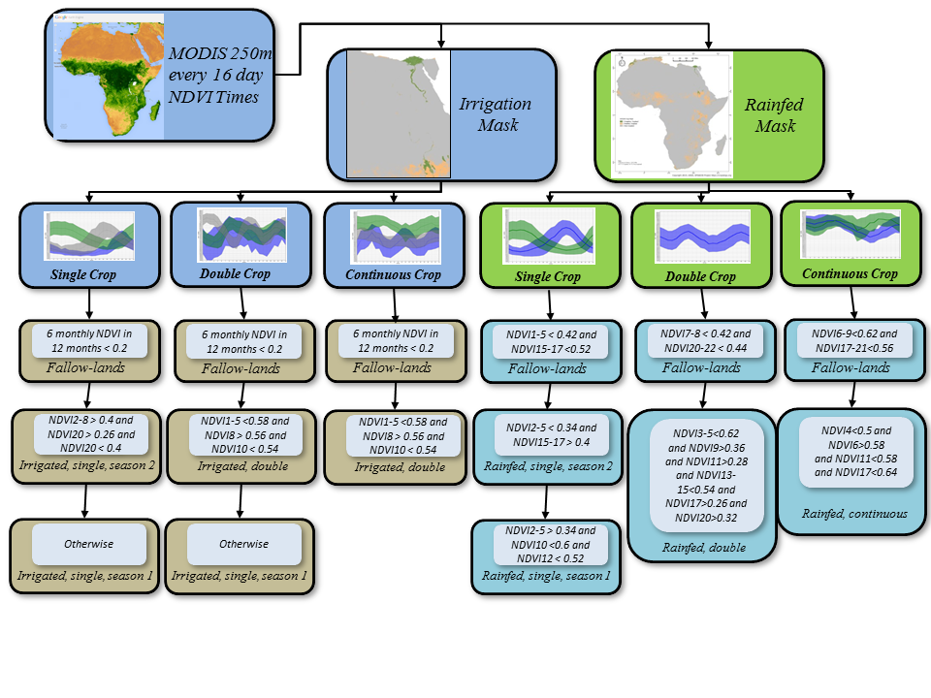
Supervised classification: Decision Trees (CART)

Slide 20
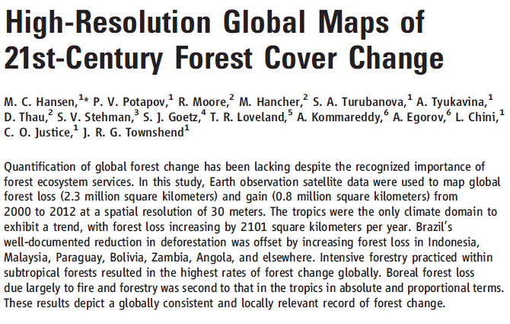
Decision Trees Applications
Method:
Percent tree cover, forest loss and forest gain training data were related to the time-series metrics using a decision tree.
Visit https://earthenginepartners.appspot.com/science-2013-global-forest

Slide 21
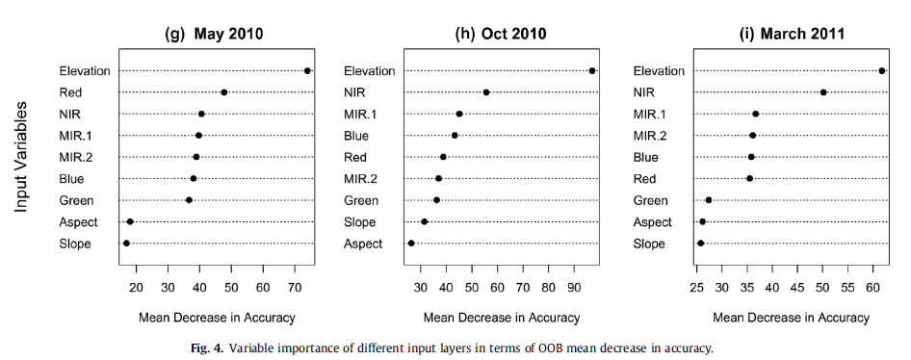
Supervised classification: Random Forest
Variable importance
Source: http://dx.doi.org/10.1016/j.apgeog.2014.01.003

Slide 22
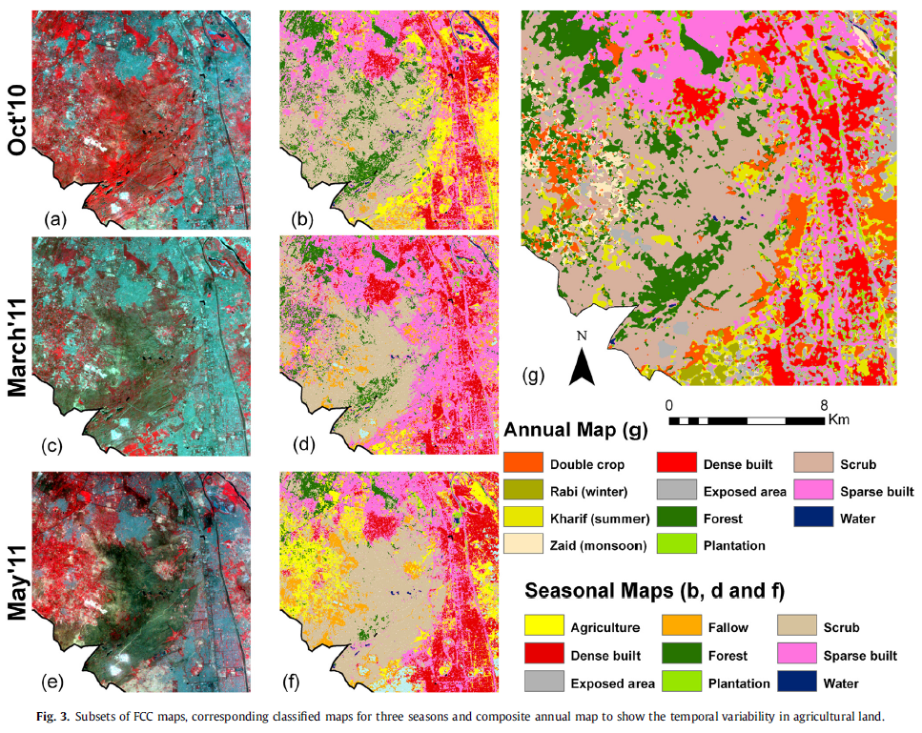
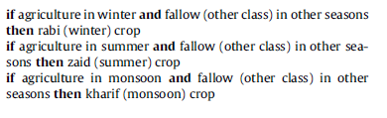
Supervised classification: Combine Classifier
Random Forest
Ruleset
Ruleset
Source: http://dx.doi.org/10.1016/j.apgeog.2014.01.003

Slide 23
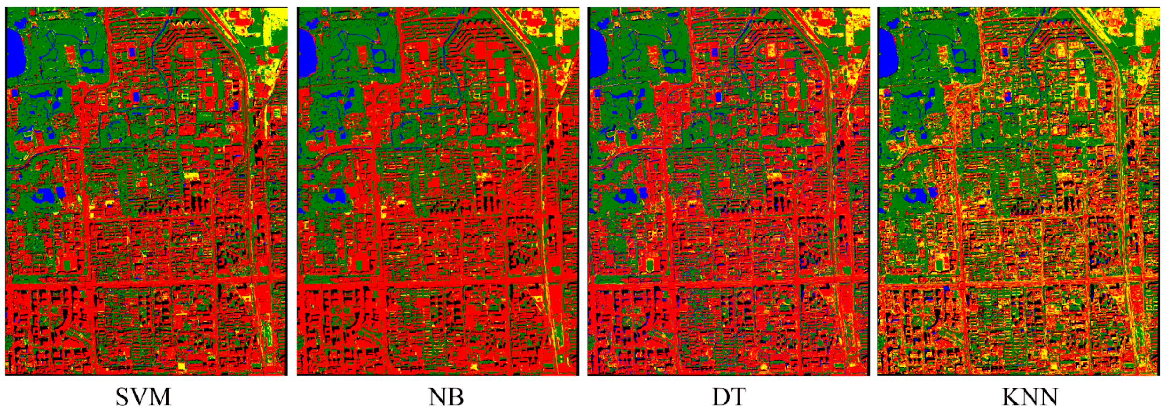
Comparison of Classifiers: I
Source: http://www.mdpi.com/2072-4292/7/1/153

Slide 24
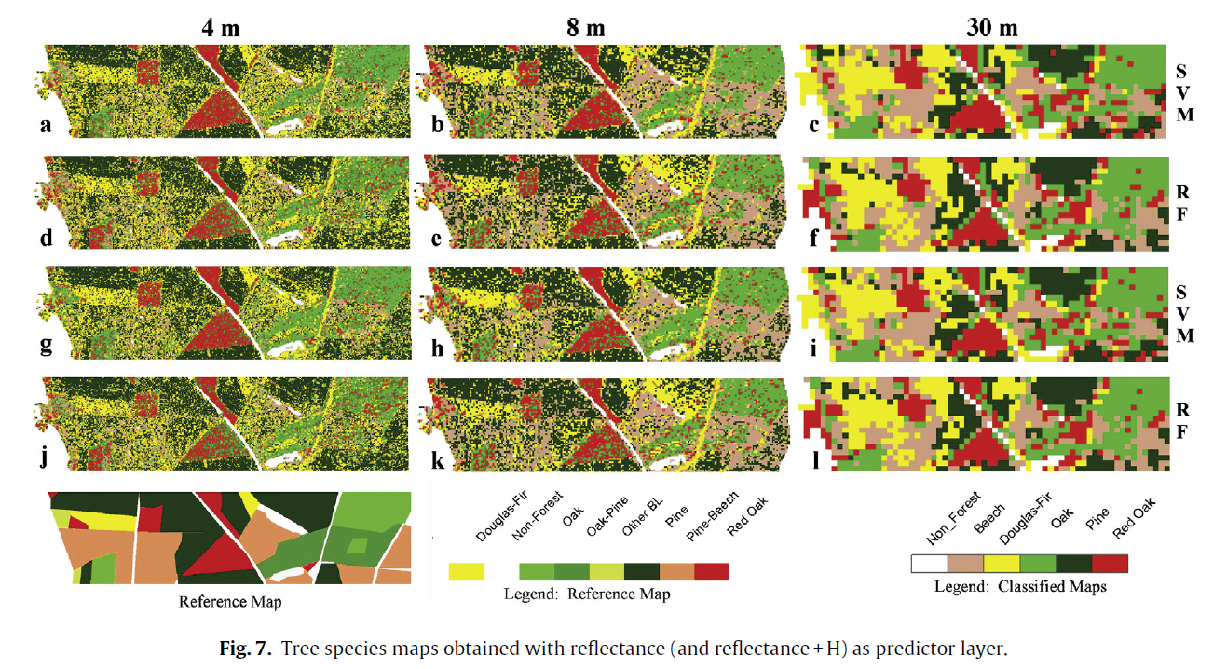
Comparison of Classifiers: II
Source: http://dx.doi.org/10.1016/j.jag.2013.05.017

Slide 25
Accuracy of Classified Maps
“Without an accuracy assessment, a classified map is just a pretty picture.”
Degree (often as a percentage) of correspondence between observation and reality
Should be validated with independent reference data
Mixed pixels due to the landscape complexity and pixel size

Slide 26
Error Matrix
A table with results given as rows and reference (ground truth) is given as columns for each sample point
Also known contingency table or confusion matrix
Mixed pixels due to the landscape complexity and pixel size
Notes:
Excellent way to summarize the results

Slide 27
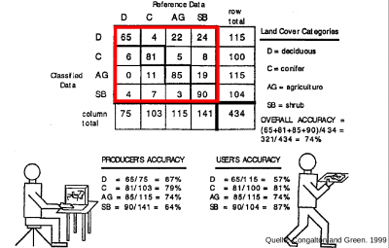
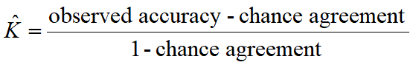
Error Matrix
Diagonals represent sites classified correctly according to reference data
Off-diagonals are mis-classified
Overall Accuracy (OA) =
Sum of Diagonals
Total number of Samples
Producer’s Accuracy: For a given class in reference plots, how many of the pixels on the map are labeled correctly?
User’s Accuracy: For a given class, how many of the pixels on the map are actually what they say they are?
Notes:
Summary value is an average; Does not reveal if error was evenly distributed between classes or if some classes were really bad and some really good. What if I randomly assign each pixel to each class? For a binary classification, I can have 50% OA. Therefore you need other measurements to quantify the off-diagonals.
Producer's Accuracy is the map accuracy from the point of view of the map maker (the producer). This is how often are real features on the ground correctly shown on the classified map or the probability that a certain land cover of an area on the ground is classified as such.
The User's Accuracy is the accuracy from the point of view of a map user, not the map maker. the User's accuracy essentially tells use how often the class on the map will actually be present on the ground. This is referred to as reliability.

Slide 28
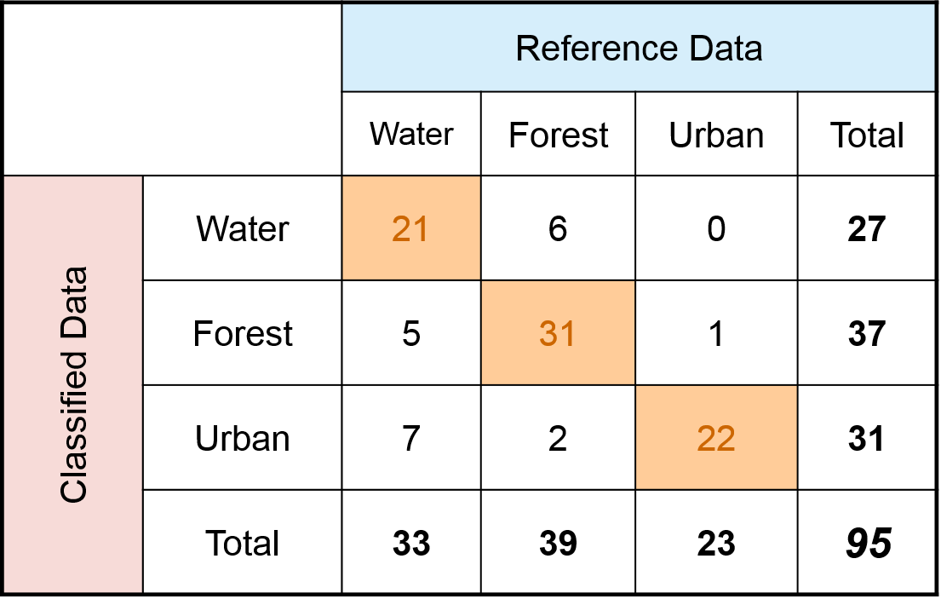
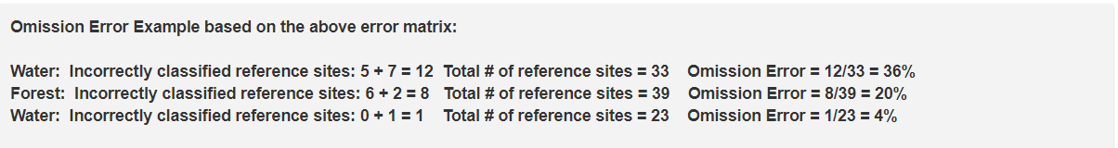
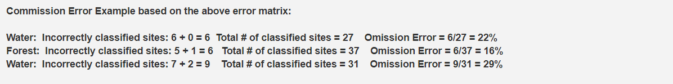
Error Matrix: Example
Errors of Omission (1-PA)
Errors of omission refer to reference sites that were left out (or omitted) from the correct class in the classified map.
Errors of Commission (1-UA)
These refer sites that are classified as to reference sites that were left out (or omitted) from the correct class in the classified map.
OA = 77.9%
Notes:
The user and producer accuracy for any given class typically are not the same. In the above examples the producer’s accuracy for the Urban class was 96% while the user's accuracy was 71%. this means that even though 96% of the reference urban areas have been correctly identified as “urban”, only 71% percent of the areas identified as “urban” in the classification were actually urban. Water (7) and forest (2) areas were mistakenly classified as urban. By analyzing the various accuracy and error metrics we can better evaluate the analysis and classification results. Often you might have very high accuracy for certain classes, while others may have poor accuracy. The information is important so you and other users can evaluate how appropriate it is to use the classified map.
http://gsp.humboldt.edu/olm_2016/Courses/GSP_216_Online/lesson6-2/metrics.html

Slide 29
Selecting classification algorithm
No pattern classification method is inherently superior to any other.
Best/optimum classification method depends on:
The nature of the classification problem,
The biophysical characteristics of the study area
The distribution of the remotely sensed data (e.g., normally distributed),
Properties of the remote sensing data
“We should have a healthy skepticism regarding studies that purport to demonstrate the overall superiority of a particular learning or recognition algorithm.” Duda et al. (2001)

Slide 30
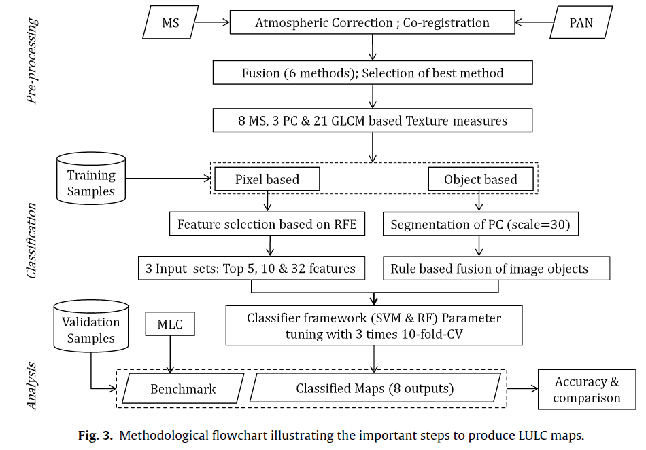
Summary
Source: http://dx.doi.org/10.1016/j.jag.2013.08.011

